Slide 1
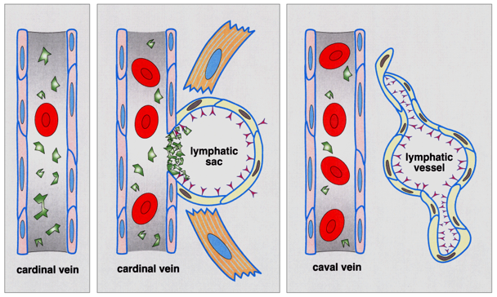
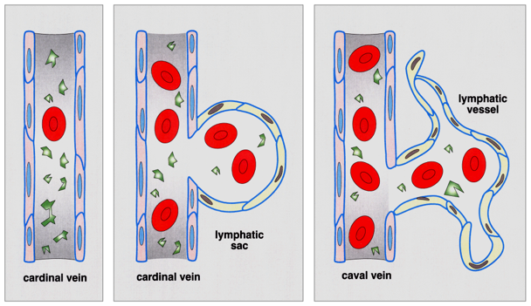
SEPARATION OF BLOOD AND LYMPHATIC CIRCULATION BY ACTIVATION OF PLATELETS VIA THE LYMPHATIC ENDOTHELIUM MUCIN PODPOPLANIN John B. Muster, Peter D. Another Institute of Science, University of Wherever
wild-type
mouse
Podoplanin
podoplanin-/- mouse

